Slide 1
Wildfire Burned Area Prediction
A Machine Learning Approach to Mitigating Climate and Environmental Risks
ACE6313 Machine Learning Concepts and Technologies (T2610)
Presenters: • Lwee Tong Jun (ID: 1211112083) - Preprocessing • Peng Ze Wei (ID: 1211108918) - ML Model
Notes:
Welcome everyone. Today we are presenting our machine learning project on Wildfire Burned Area Prediction. Wildfires are an escalating threat due to climate change, and predicting their potential size at ignition is vital for resilient early response. This project details our data engineering, model exploration, and optimization efforts.

Slide 2
Alignment with UN SDG 13: Climate Action
SDG 13 CLIMATE ACTION
Building tools for resilience, early warning, and carbon emissions reduction through forest preservation.
SDG Target 13.1 (Resilience & Adaptability): Providing prediction tools to enhance disaster preparedness and emergency response times.
SDG Target 13.3 (Early Warning & Awareness): Utilizing geographic and seasonal patterns to formulate regional and industrial warnings.
Climate Mitigation: Successful early containment prevents catastrophic carbon emissions from burning forests, protecting critical carbon sinks.
Notes:
Our project aligns directly with UN Sustainable Development Goal 13: Climate Action. By building systems that predict fire sizes at ignition, we strengthen local disaster resilience (Target 13.1) and support institutions in developing targeted risk warnings and restrictions (Target 13.3).

Slide 3
Problem Statement & Objectives
The Problem
Wildfire spread is highly chaotic, governed by weather, fuel, topography, and administrative response times.
Forecasting final fire size (EstTotalAcres) at the moment of ignition is a highly non-linear, right-skewed regression task.
Key Objectives
1. Preprocessing Pipeline: Develop a clean data preprocessing pipeline (cleaning, feature extraction).
2. Leakage Prevention: Enforce strict feature selection to prevent target leakage.
3. Model Comparison: Train and compare 6 distinct regression models (Linear Regression, kNN, Decision Trees, Random Forest, Gradient Boosting, MLP).
4. Dimensional Reduction: Test PCA's efficacy for dimensional reduction on tree and neural models.
5. Optimization: Optimize the top-performing model through hyperparameter tuning.
Notes:
The main challenge of this task is predicting a highly skewed continuous variable using administrative data. Our objective is to evaluate multiple machine learning regressors on their ability to handle this data, prevent leakage, and optimize the best-performing model.

Slide 4
Data Preprocessing & Cleaning
Dataset & Cleaning
Dataset: Oregon Department of Forestry (ODF) Fire Occurrence dataset (2000–2023, 23,490 raw records).
Data Cleaning: Handled missing records, filtered coordinates, leaving 23,202 clean samples.
Target Leakage Prevention
Dropped Size_class: Size classes (A-G) are directly calculated from final acreage, creating automatic target leakage.
Dropped Control_DateTime: Containment times are only known post-event, making them unavailable at ignition.
Removed Metadata: Serial numbers, names, and unique IDs which contain no predictive value.
Notes:
A key part of our preprocessing was preventing target leakage. If we included the fire size class or the control datetime, the models would perform artificially well, but these features are unknown when a fire is first detected. Therefore, they were strictly removed.

Slide 5
Feature Engineering & Encoding
Temporal Feature Engineering
Ignition DateTime Parsing: Parsed Ign_DateTime to extract seasonal and daily indicators.
Ign_Month: Captures seasonal risk profiles, representing seasonal climate cycles.
Ign_Hour: Captures peak daily temperature periods and daily cycles.
Categorical Encoding Strategy
High-Cardinality Dilemma: Applying one-hot encoding to high-cardinality geographic columns (Twn, Rng, Subdiv) creates 23,463 sparse features, leading to overfitting.
Label Encoding Solution: Applied category coding (Label Encoding) to retain a compact feature space of 24 dense features, maintaining generalizability.
Notes:
We extracted month and hour from the ignition timestamp to represent seasonal and daily cycles. Furthermore, due to high-cardinality in categorical features, we used label category encoding to keep the features compact, as one-hot encoding exploded the dataset to over 23,000 sparse columns.

Slide 6
Machine Learning Algorithms
Evaluation of 6 Regressors
Parametric Baseline: Linear Regression
Instance-Based: k-Nearest Neighbors (kNN)
Non-Parametric Trees: Decision Trees, Random Forest, and Gradient Boosting
Neural Network: Multi-Layer Perceptron (MLP)
Feature Scaling
Standardization: Standardized all continuous and encoded variables using StandardScaler.
Reasoning: Ensures equal feature weighting for distance (kNN) and weight-based gradient updates (MLP) to avoid scaling bias.
Notes:
We evaluated a broad range of models, including parametric, instance-based, tree-based ensembling, and neural network regressors. Feature standardization was applied to ensure that distance and gradient-based models were not biased by feature scales.

Slide 7
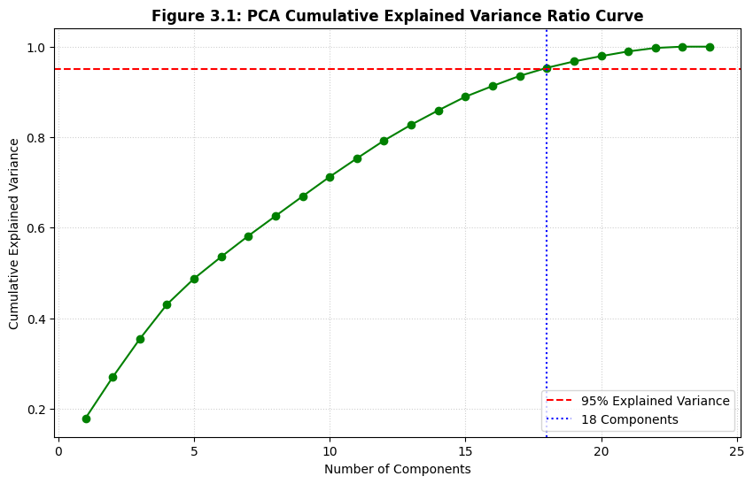
Feature Reduction via PCA
PCA Setup & Key Findings
PCA Configuration: Applied Principal Component Analysis targeting 95% explained variance.
Compression: Reduced the feature space from 24 features to 18 orthogonal components.
Severe Tree Degradation: Random Forest R² fell from +0.1220 (Standard) to -0.0841 (PCA).
Why? PCA creates linear combinations of features, which destroys the axis-aligned splits and local boundaries that decision trees rely on.
Notes:
We conducted an experiment using PCA to reduce our features to 18 components. However, PCA degraded performance. For instance, Random Forest R² dropped below zero. This is because PCA's linear combinations destroy the axis-aligned spatial splits that decision trees use to partition data.

Slide 8
Model Performance Comparison
Model / Algorithm | Standard R² | Standard RMSE (Acres) | PCA R²
Random Forest (Top Model) | 0.1220 | 6951.77 | -0.0841
Linear Regression | -0.0088 | 7451.70 | -0.0092
MLP (Neural Net) | -0.0168 | 7481.42 | -0.0125
kNN | -0.0284 | 7523.84 | -0.0342
Gradient Boosting | -0.0419 | 7572.92 | -0.0144
Decision Tree | -1.1923 | 10985.28 | -0.2132
Notes:
Here we see the results. On standard features, Random Forest was the only algorithm that achieved a positive R² score of 0.122. All other models, including Linear Regression and Neural Nets, struggled, highlighting the complex non-linear relationships in the data. PCA degraded tree models but slightly stabilized MLP and Gradient Boosting.

Slide 9
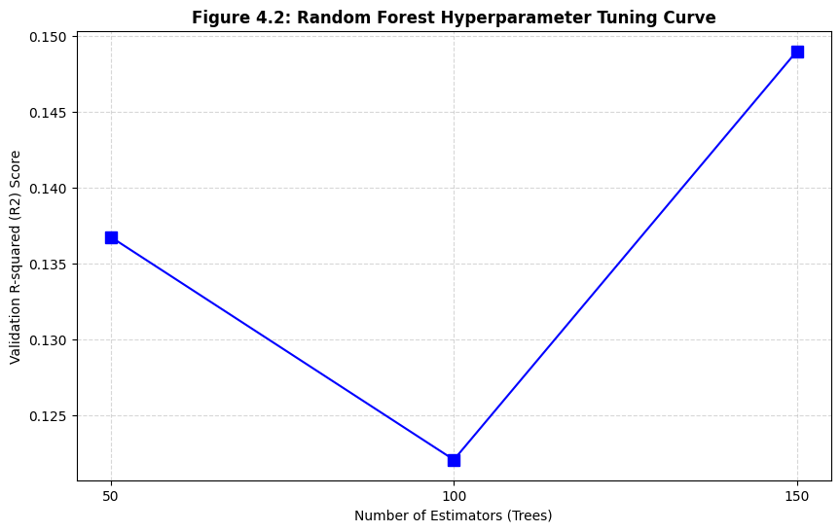
Random Forest Hyperparameter Tuning
Optimizing Ensemble Size
Ensemble Size (n_estimators): Evaluated the impact of ensemble size on prediction performance:
• 50 trees: R² = 0.1367
• 100 trees (Baseline): R² = 0.1220
• 150 trees (Best): R² = 0.1490 (RMSE = 6844.21 acres)
Performance Summary: Optimization yielded a +2.7% baseline improvement in R² and reduced the prediction error (RMSE).
Notes:
To optimize our top model, we tuned the number of estimators in the Random Forest. Increasing the number of trees to 150 allowed the model to stabilize its variance, improving the final R² score to 0.1490 and successfully decreasing the RMSE.

Slide 10
Selected Final Model & Configuration
Chosen Model Configuration
Model Selection: Random Forest Regressor
Optimized Hyperparameter: n_estimators = 150 (150 decision trees)
random_state: 42 (for absolute reproducibility)
criterion: 'squared_error' (mean squared error loss)
max_depth: Unlimited (grown fully to capture complex thresholds)
Final Evaluation Results
Final R² Score: 0.1490 (+2.7% relative improvement over baseline)
Final RMSE: 6844.21 acres (reduced from 6951.77 acres)
Key Strength: Superior generalizability over non-ensemble architectures on non-linear ODF features.
Notes:
Following our hyperparameter tuning, we selected the Random Forest Regressor with 150 trees as our final optimized model. This configuration yields our best generalization performance, achieving an R² score of 0.1490 and reducing our RMSE to 6844.21 acres. This slide outlines the exact parameters used. Now, let's discuss the overall results and the challenges we faced.

Slide 11
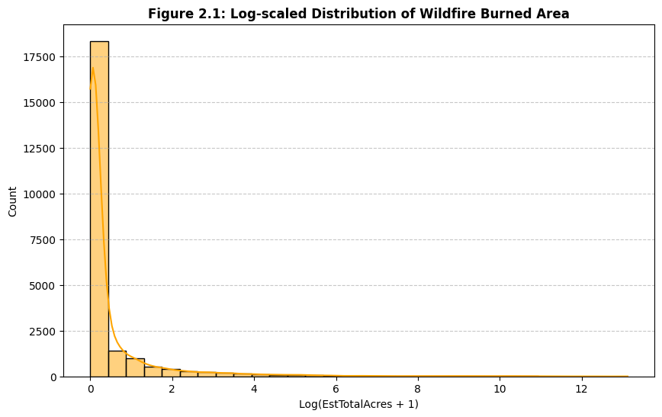
Results Discussion & Challenges
Key Challenges
Highly Skewed Target Distribution: Wildfires follow a power-law distribution. Most fires are very small (< 1 acre), but a few massive fires account for the bulk of burned acres.
MSE/RMSE Penalty: Standard regression loss functions (MSE/RMSE) quadratically penalize errors on these extreme outliers, driving high volatility.
Missing Meteorological Predictors: Administrative data is static. Predicting fire spread requires dynamic parameters like wind speed, fuel dryness, temperature, and relative humidity.
Notes:
Although Random Forest successfully extracted predictive patterns, the final R² is 0.1490. This reflects two physical bottlenecks: first, wildfire sizes follow a power-law distribution where extreme outliers dominate the squared error; second, administrative data lacks real-time weather features like wind speed and dryness which dictate physical fire spread.

Slide 12
Conclusion & Future Work
Key Achievements
Leakage-Free Pipeline: Developed a leakage-free ML pipeline; identified Random Forest as the superior regressor; analyzed PCA's limitations on tree ensembling.
Proposed Future Work
Log Transformation: Train models on log(Acres + 1) to compress skewed outliers.
Weather Data Integration: Merge historical fire coordinates with meteorological data (NOAA, ERA5).
Classification Reframing: Predict discrete fire size categories (A through G) for actionable resource staging.
Notes:
In conclusion, we built a leakage-free wildfire prediction framework. For future work, we recommend log-transforming the target variable to reduce skewness, integrating historical hourly weather data, and reframing the regression task into size-class classification to support emergency staging.

Slide 13
Team Contributions & Reflections
Lwee Tong Jun (Data Preprocessing)
Contributions: Target leakage discovery, datetime engineering, categorical coding design.
Key Learning: Practical leakage resolution and categorical representation trade-offs in real-world GIS databases.
Peng Ze Wei (ML Models)
Contributions: Implementation of 6 regressors, scaling, PCA design, RF tuning.
Key Learning: Understanding PCA's destructive effect on non-linear decision boundaries and interpreting regression metrics in skewed datasets.
Notes:
To summarize our team reflections, Lwee Tong Jun focused on the data preprocessing, learning the importance of leakage removal and category representation. Peng Ze Wei managed the model architectures, learning the limitations of PCA and the challenges of regression on skewed data. Our close coordination ensured an integrated end-to-end pipeline.

Slide 14
Thank You!
Wildfire Burned Area Prediction
Aligned with UN SDG 13: Climate Action
Lwee Tong Jun & Peng Ze Wei Questions & Answers
Notes:
Thank you for your time. We are now open to any questions.

